Slide 1

经济学原理：第三讲
蔡洪滨
北京大学光华管理学院

Slide 2
Ch. 3: Basics of Supply and Demand
A. The Demand Schedule
B. The Supply Schedule
C. Equilibrium of Supply and Demand

Slide 3
Economic vs. Engineering Approach
Global proven conventional oil reserves:
  1,028,500,000,000 barrels
Global oil consumption per day
  82,400,000 barrels
Global oil consumption per year
  30,076,000,000 barrels
Question: How many years will the oil reserves support the global oil consumption? 35 years?

Slide 4
Unfulfilled Prophecy
Professor Ehrlich at Stanford warned in 1970 that the world supply of oil and gasoline will be exhausted by 2000
This prediction, which was elaborated in the book The Limit of Growth, published by the Club of Rome, shocked the world.
The oil price skyrocketed by 350% during 1973－1974
But the oil crisis didn’t come, and oil prices fluctuated in the past 40 years.

Slide 5
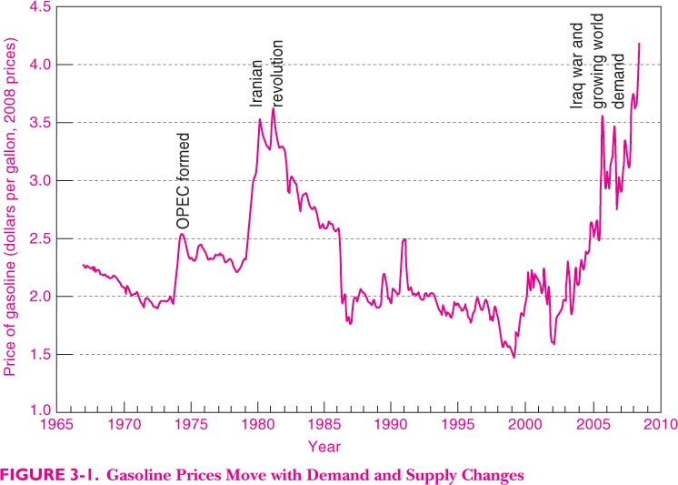

Slide 6
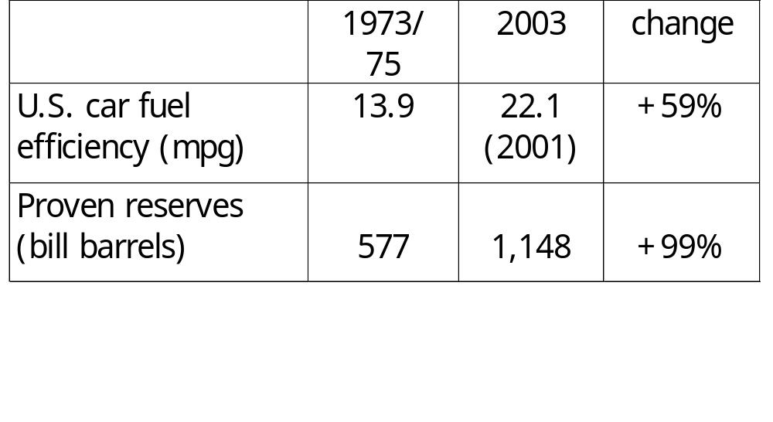
Forces of the Market Mechanism

Slide 7
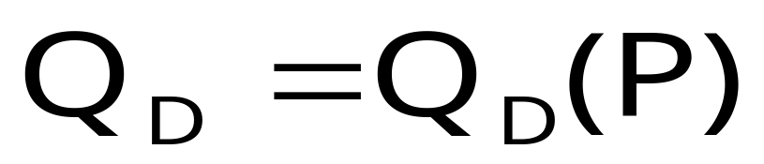
A. The Demand Curve
The Demand Curve
  The relationship between the quantity of a good that consumers are willing to buy and the price of the good
  Measures quantity on the x-axis and price on the y-axis

Slide 8
The Demand Curve
Price
($ per unit)
The demand curve slopes
downward, demonstrating
that consumers are willing
to buy more at a lower price
as the product becomes
relatively cheaper.
P₂
P₁
D
Q₁
Q₂
Quantity

Slide 9
Law of Demand
Quantity demanded tends to fall as price rises
This is driven by two effects
The substitution effect: A good becomes relatively more expensive when its price rises, which makes consumers shift demand for other goods
The income effect: When a price goes up, consumers find themselves somewhat poorer than they were before

Slide 10

Forces behind The Demand Curve
Other Factors Affecting Demand
  Income
    Increases in income allow consumers to purchase more at all prices
  Consumer Tastes
  Market size measured by the population
  Price of Related Goods
    Substitutes
    Complements

Slide 11
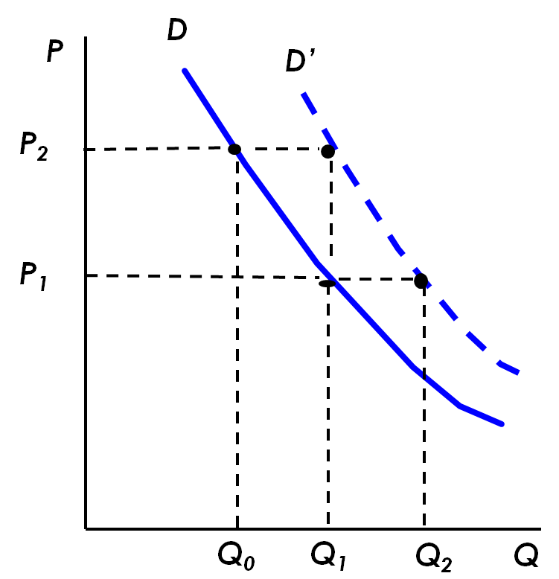
Change in Demand
Income Increases
  Purchased Q₀, at P₂ and Q₁ at P₁
  Now purchased Q₁ at P₂ and Q₂ at P₁
  Same for all prices
  Demand curve shifts right

Slide 12
Two Different Kinds of Changes in Demand
Changes in quantity demanded
  Movements along the demand curve caused by a change in price
Shifts in demand
  A shift of the entire demand curve caused by something other than price
    Income
    Preferences………

Slide 13
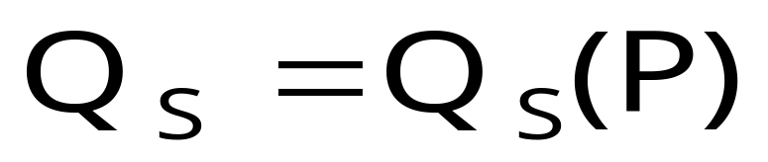
B. The Supply Curve
The Supply Curve
  The relationship between the quantity of a good that producers are willing to sell and the price of the good
  Measures quantity on the x-axis and price on the y-axis

Slide 14
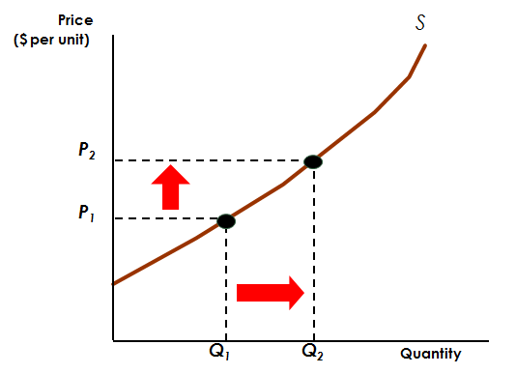
The Supply Curve
The Supply Curve, Graphically Depicted
The supply curve slopes
upward, demonstrating that
at higher prices firms
will increase output

Slide 15
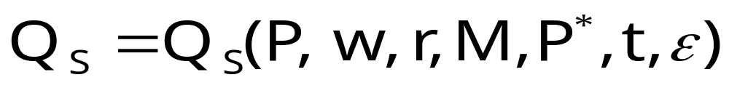
The Supply Curve
Other Factors Affecting Supply
  Costs of Production
    Labor
    Capital
    Raw Materials
  Technological advances:
  Prices of Alternative Outputs:
  Government policy: tax or subsidy

Slide 16
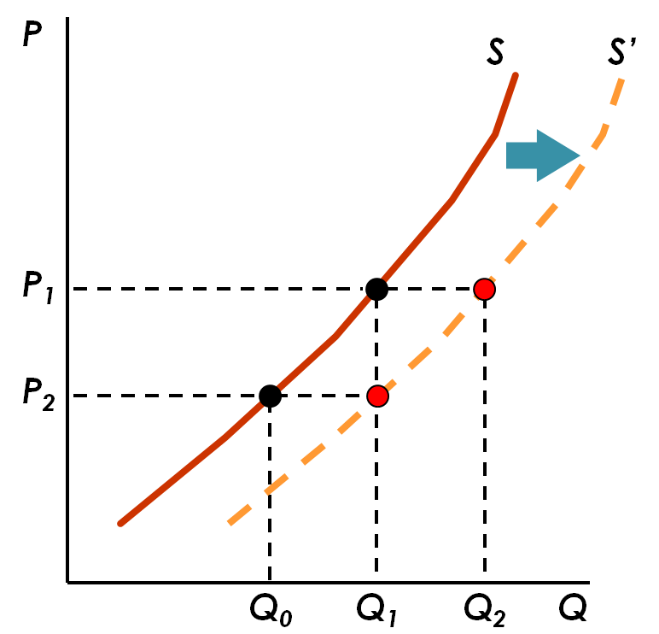
Change in Supply
The cost of raw materials falls
  Produced Q₁ at P₁ and Q₀ at P₂
  Now produce Q₂ at P₁ and Q₁ at P₂
  Supply curve shifts right to S’

Slide 17
Two Kinds of Changes in Supply
Change in Quantity Supplied
  Movement along the curve caused by a change in price
Shifts in Supply
  Shift of the curve caused by a change in something other than the price of the good
    Change in costs of production
    Change in government policy (e.g., imports)

Slide 18
C. Equilibrium of Demand and Supply
The market mechanism is the tendency in a free market for price to change until the market clears
Markets clear when quantity demanded equals quantity supplied at the prevailing price
Market clearing price – price at which markets clear, that is, when supply meets demand.

Slide 19
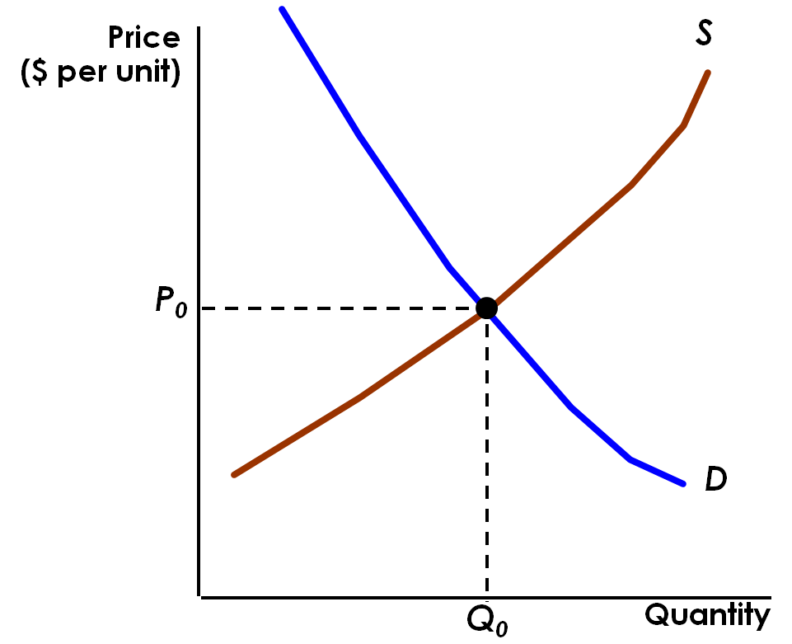
The Market Equilibrium
The curves intersect at
equilibrium, or market-
clearing, price.
Quantity demanded equals quantity supplied at P₀

Slide 20
The Market Equilibrium
In equilibrium
  There is no shortage or excess demand
  There is no surplus or excess supply
  Quantity supplied equals quantity demanded
  Anyone who wants to buy at the current price can buy and all producers who want to sell at that price can sell.

Slide 21
What if the Market Doesn’t Clear
Supply and demand interact to determine the market-clearing price
When not in equilibrium, the market will adjust to alleviate a shortage or surplus and return the market to equilibrium
Markets must be competitive (many small buyers and sellers) for the mechanism to be efficient.

Slide 22
Market Surplus
The market price is above equilibrium
  There is excess supply - surplus
  Downward pressure on price
  Quantity demanded increases and quantity supplied decreases
  The market adjusts until new equilibrium is reached

Slide 23
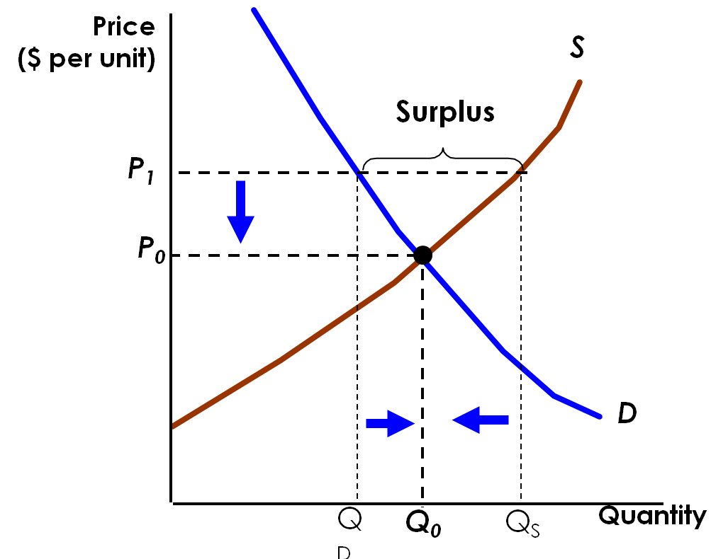
The Surplus Case
At P₁, price is above the market clearing price
Q_{s} > Q_{D}
Price falls to the market-clearing price
Market adjusts to equilibrium

Slide 24
When Supply Doesn’t Catch up with Demand
The market price is below equilibrium:
  There is excess demand - shortage
  Upward pressure on prices
  Quantity demanded decreases and quantity supplied increases
  The market adjusts until the new equilibrium is reached

Slide 25
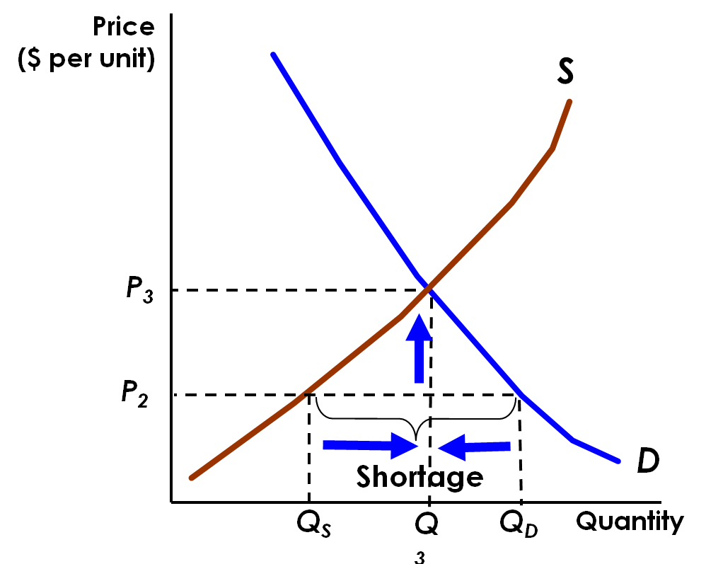
The Shortage Case
At P₂, price is below the market clearing price
Q_{D} > Q_{S}
Price rises to the market-clearing price
Market adjusts to equilibrium

Slide 26
Changes in Market Equilibrium
Equilibrium prices are determined by the relative level of supply and demand
Changes in supply and/or demand will cause change in the equilibrium price and/or quantity in a free market

Slide 27
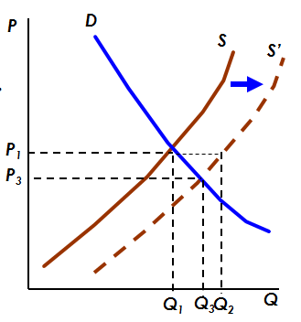
Changes in Market Equilibrium
Raw material prices fall
  S shifts to S’
  Surplus at P₁ between Q₁, Q₂
  Price adjusts to equilibrium at P₃, Q₃

Slide 28
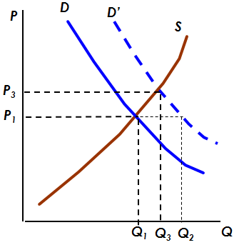
Changes in Market Equilibrium
Income Increases
  Demand increases to D’
  Shortage at P₁ of Q₁ to Q₂
  Equilibrium at P₃ and Q₃

Slide 29
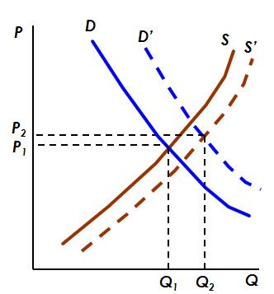
Changes in Market Equilibrium
Income increases and raw material prices fall
  Quantity increases
  If the increase in D is greater than the increase in S， price also increases

Slide 30
Shifts in Supply and Demand
When supply and demand change simultaneously, the impact on the equilibrium price and quantity is determined by:
  The relative size and direction of the changes
  The shape of the supply and demand curves
Four cases of price and quantity changes (Table 3.6)

Slide 31
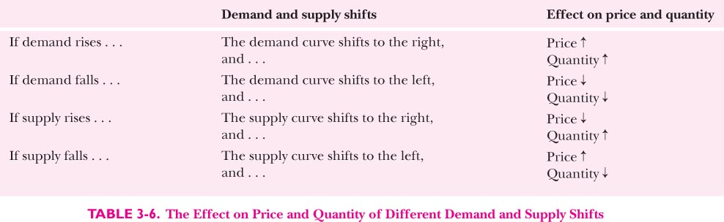

Slide 32
The Economics of Immigration
One would expect that immigration into a region increases supply and pushes down wages
Economic studies show that in the United States a 10% increase in the fraction of immigrants in the population reduces native wages by at most 1 %
Why? New immigrants tend to move to cities with strong labor demand and quickly spread around the entire country while natives may move out if the wage is driven down

Slide 33
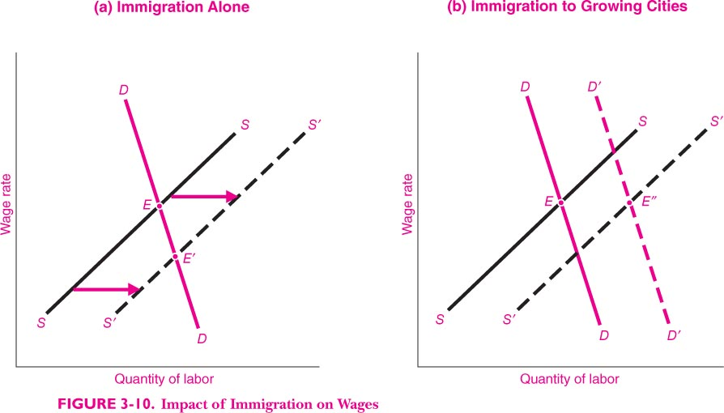

Slide 34
More Road, More Traffic?
Traffic jams are the headache of city planners and ordinary people
A possible solution is to increase road network
More road will alleviate congestion
According to some quantitative studies, the increase in the road capacity is exactly matched by the increase in traffic volume

Slide 35
Reminder:
  Review Chapter 3
  Preview Chapter 4
  Homework 1 due on September 21 in class.
  Thank you!

Slide 36
The Long-Run Behavior of Natural Resource Prices
  Consumption of copper has increased about a hundredfold from 1880 through 2002
  The long term real price for copper has remained relatively constant
  Increased demand as world economy grew
  Decreased production costs increased supply
  Decreases in the costs of production have increased the supply by more than enough to offset the increase in demand

Slide 37
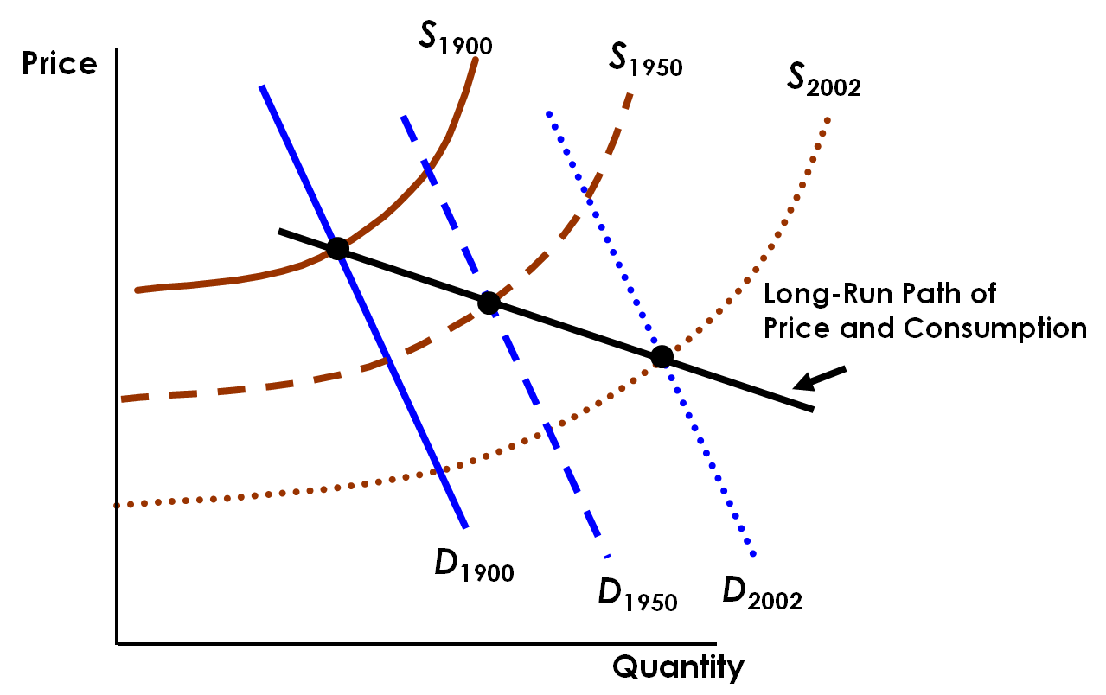
Resource Market Equilibrium

